Slide 1

Proposal for Required improvements to state “how to fulfill”

Slide 2
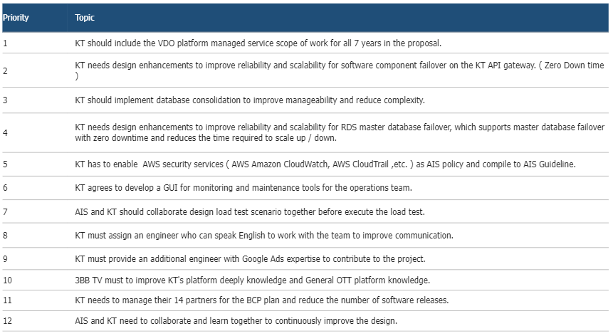
Notes:
Firstly, I will do explain project organization and resource for implementation and maintenance.
Secondly, I will cover managed service in details according to ais reruirements.

Slide 3



1
Required improvements
Priority Topic
KT Should include the VDO platform managed service scope of work for all 7 years in the proposal
We understand exactly the scope of the project’s implementation and managed service
STB Soft
launch
All FE
launch
Timeline
Front-End
(including Analytics)
ATV Soft Launch
All FE Launch
ATV
PATC (FE)
FATC (FE)
Commercial
All FE
90 Days
Commercial
OVP
OVP
OVP
PATC (OVP)
FATC (OVP)
Commercial
90 Days
OVP
OVP
Frontend
Managed Service
Start
OVP Warranty
Start
FE Warranty
Start
Notes:
@ㅇ 숫자확인필요. Org의 숫자와 리소스의 숫자 확인. 필요시 org의 숫자는 제거.

Slide 4
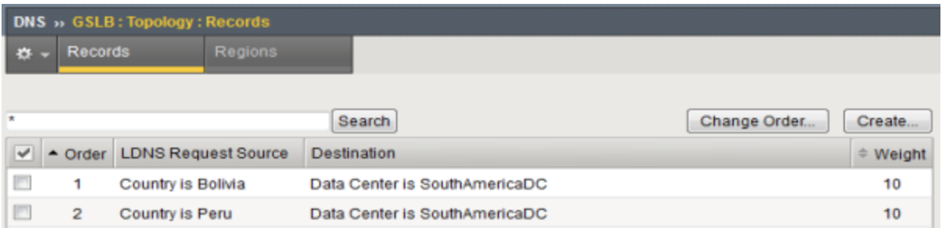
2
Required improvements
Priority Topic
KT needs design enhancements to improve reliability and scalability for software component failover on the KT API Gateway (Zero Down time)
- We explain the defense logic for zero down time and the architectural methodology for minimizing down time in case of section-by-section fail-over.
1 | In case of network disconnection caused by Route 53 DNS failure and AZ zone transfer, STB and OTT provide service with zero down time through retry logic. * Refer to page 5.
2 | In the event of an On premise IDC1,2 failure, the service is provided without downtime by switching from GSLB to AWS.
3 | When onpremise bulk event calls flow in, only the read API is switched to AWS using APIGW's routing function to protect Onpremise services while processing bulk traffic using AWS scalability. * Refer to “Hybrid Architecture v0.9 number 4
4 | In the event of a DB failure, MBS provides an authentication-free function and queuing function to provide immediate service and zero service downtime. * Refer to page 6
5 | APIGW provides throttling, load balancing, routing, and circuit breaker functions to ensure service high availability and DVP system stability. * Refer to page 7,8
6 | In case of DB Master-standby fail-over, downtime is minimized by building Aurora and application with Advanced JDBC Wrapper Driver. * Refer to page 10 (Aurora Database)
1
2
5
3
6
4
Hybrid Architecture v0.9
Notes:
@ㅇ 숫자확인필요. Org의 숫자와 리소스의 숫자 확인. 필요시 org의 숫자는 제거.

Slide 5
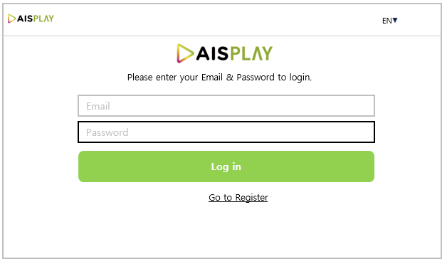



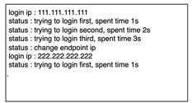


2
Required improvements
Priority Topic
In case of network disconnection caused by Route 53 DNS failure and AZ zone transfer, STB and OTT provide service with zero down time through retry logic.
STB will attempt to log in to the Master Server of the Private Cloud with 1st URL
In the case of a failed connection to the Master Server in the Private Cloud, try 3 times
If all 3 failed connections, try logging in to the Slave Server in the Private Cloud with 2nd URL
If all 3 failed connections, try logging in to the Master Server in the Public Cloud with 3rd URL
The login status will be displayed on the STB screen like Server IP and retry time
After successful login, run Test VOD to verify normal AV playback
1
Private Cloud
Master Server
Retry 3 times
2
3
5
Private Cloud
Slave Server
4
6
Public Cloud
Master Server

Slide 6
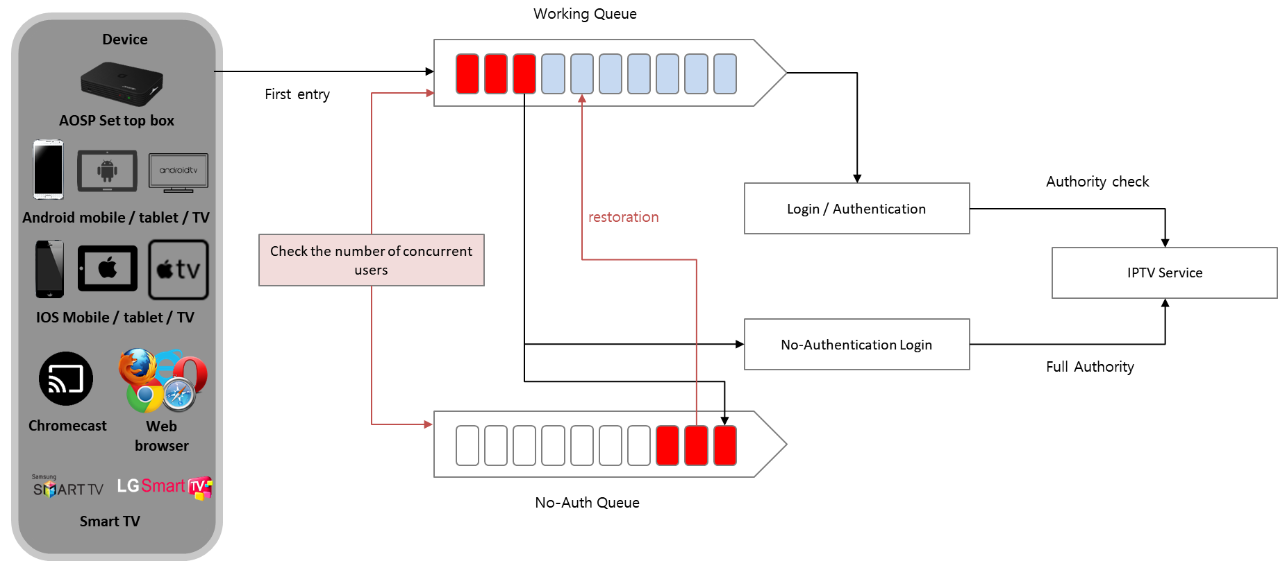
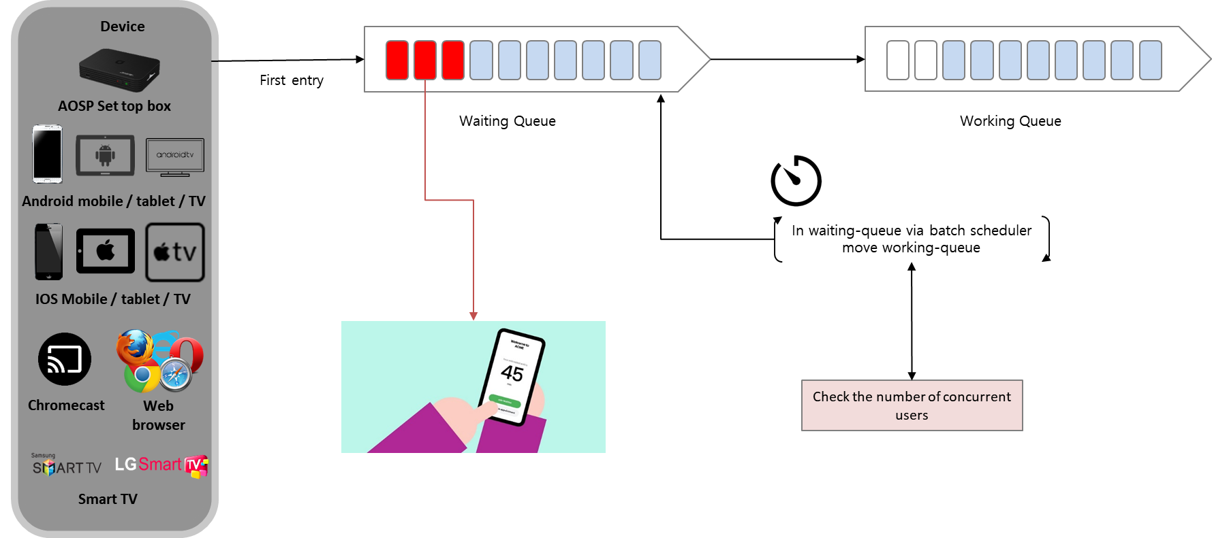
2
Required improvements
Priority Topic
In the event of a DB failure, MBS provides an authentication-free function and queuing function to provide immediate service and zero service downtime.
No-Auth Service / Waiting Queue Service
Stable service through traffic control when high-capacity traffic occurs (in case of Olympics or World Cup)
No-Auth Service | Waiting Queue Service
The no-auth service temporarily allows all services to be used without logging in during overload.
The waiting-queue service allows only as many users as allowed by the server to enter sequentially.

Slide 7
2
Required improvements
Priority Topic
APIGW provides throttling, load balancing, routing, and circuit breaker functions to ensure service high availability and DVP system stability
Designed for increased availability
Multiple Availability Zone Deployments
API Gateway can be deployed across multiple Availability Zones to support automatic failover between Availability Zones (AZs). This ensures that if one Availability Zone fails, you can automatically switch to another Availability Zone to provide uninterrupted service.
Load balancing
we can use a load balancer to evenly distribute traffic across multiple API Gateway instances. This helps prevent overload of individual API Gateway instances and increases the availability of the entire system.
Kubernetes-based architecture design
we can deploy API Gateway using Kubernetes, a container orchestration platform. Kubernetes can improve the availability and scalability of your API gateway by providing features such as auto-scaling, self-healing, and load balancing.
Notes:
@ㅇ 숫자확인필요. Org의 숫자와 리소스의 숫자 확인. 필요시 org의 숫자는 제거.

Slide 8
2
Required improvements
Priority Topic
Circuit break and throttling functions are provided through APIGW to prevent the spread of failures and provide fault tolerance.
Client
API Gateway
Designed for failover reliability
Circuit Breaker pattern application
Use the Circuit Breaker pattern to break down failures between the API gateway and backend services. We can quarantine. This prevents failures in one service from affecting other services.
Failover between Availability Zones
By deploying API Gateway across multiple Availability Zones, if one Availability Zone fails, it automatically switches to another Availability Zone to provide uninterrupted service.
Apply API Throttling
We can avoid overloading your API gateway by using the API Throttling feature, which limits the rate and number of API requests. This increases the availability and reliability of your API Gateway.
Throttling
Service
Define throttling policy for each service
BigScreen
traffic control
Service
#1
sec
min
HH
DD
20
-
-
100
MM
-
Service
#1
sec
min
HH
DD
-
-
-
-
MM
1000
Based on traffic, 1 item is deducted, and if all are deducted, an HTTP 429 (Too Many Requests) error response is received.
SmallScreen
Circuit Breaker
success
Define fault propagation blocking policy for each API system
service #1
success
division | explanation
Reach time (seconds) | Failure rate aggregation reference period
Minimum number of cases (cases) | Minimum number of traffic occurrences
failure rate(%) | Ratio of number of failures to total number of cases
Block duration (seconds) | blocking duration
service #2
Error (503)
service #3
Fail
blocking
….
success
service #N
Notes:
@ㅇ 숫자확인필요. Org의 숫자와 리소스의 숫자 확인. 필요시 org의 숫자는 제거.

Slide 9
3
Required improvements
Priority Topic
KT should implement database consolidation to improve manageability and reduce complexity.
In order to improve database manageability and reduce complexity, we will manage databases into three group by considering traffic volume and service importance.
Group1: CMS, DBS, WEB, REC, SER, Multi-CDN
Group2: MKTG, T&C, LiveChat, MBS SVC
Group3: E2E, UCEMS, MBS APIGW
Aurora Group #1
CMS, DBS, WEB, REC, SER, Multi-CDN
Aurora Group #2
MKTG , T&C, LiveChat, MBS SVC
Aurora Group #3
E2E , UCEMS, MBS APIGW
Notes:
@ㅇ 숫자확인필요. Org의 숫자와 리소스의 숫자 확인. 필요시 org의 숫자는 제거.

Slide 10

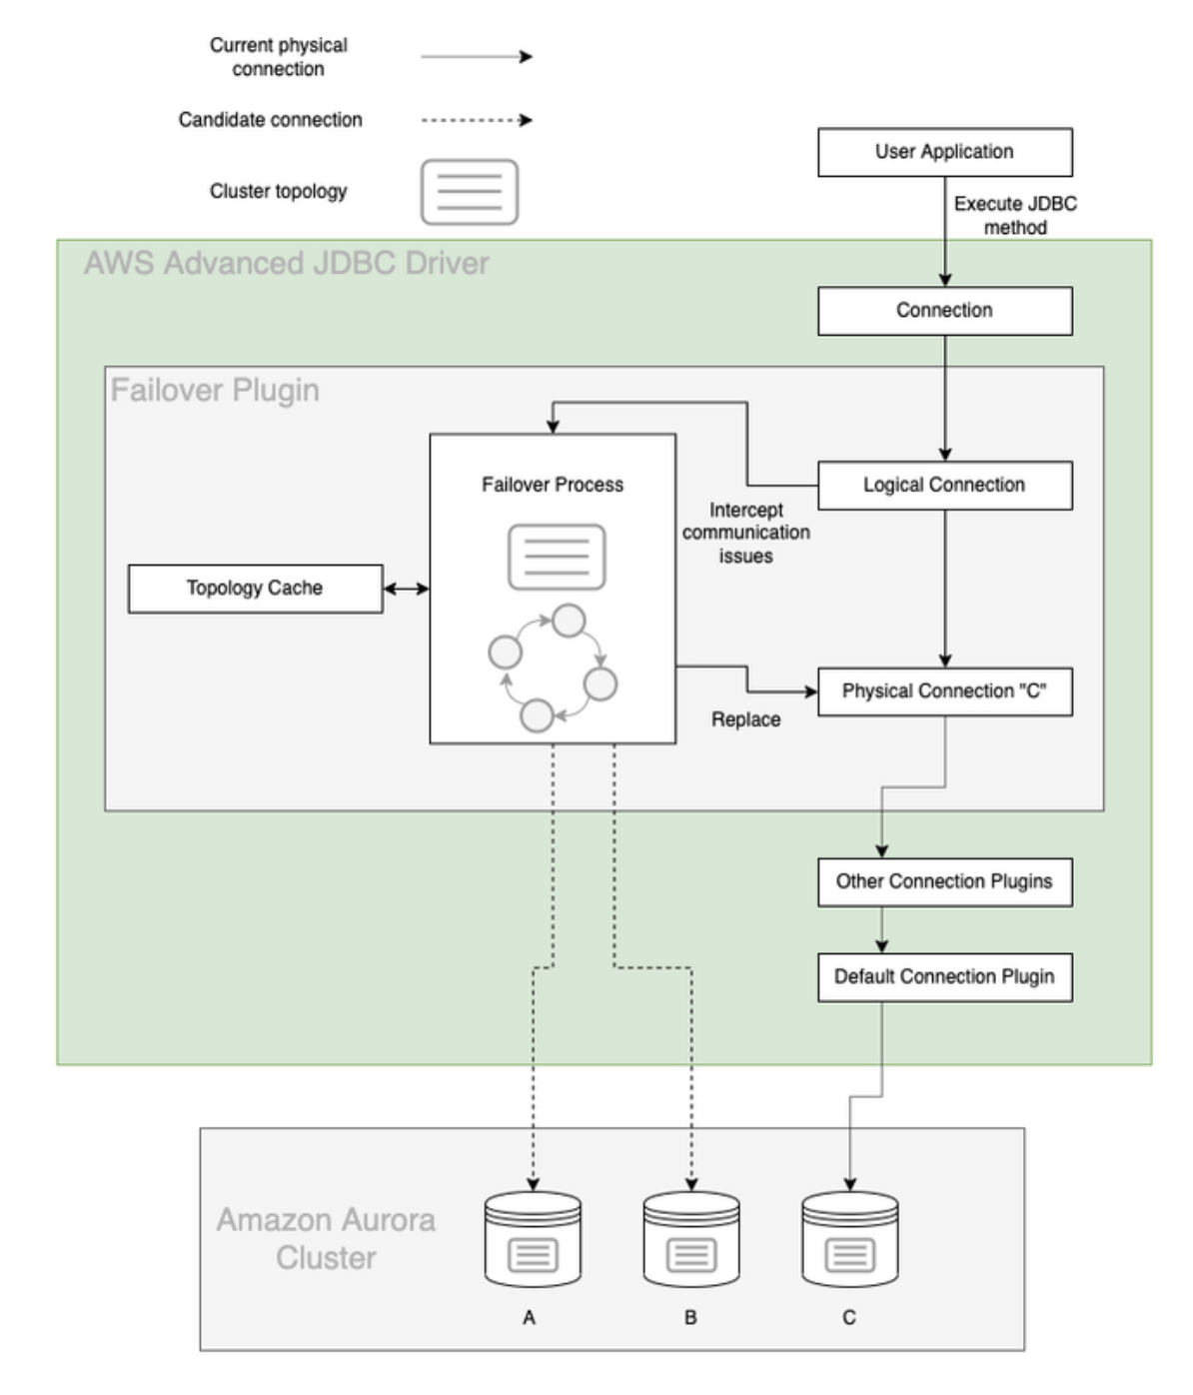
4
Required improvements
Priority Topic
KT needs design enhancements to improve reliability and scalability for RDS master database failover or to change the database to Aurora Database, which supports master database failover with no downtime.
If the DB cluster has one or more Aurora Replicas, then an Aurora Replica is promoted to the primary instance during a failure event. A failure event results in a brief interruption, during which read and write operations fail with an exception. However, service is typically restored in less than 60 seconds, and often less than 30 seconds. To increase the availability of your DB cluster, we recommend that you create at least one or more Aurora Replicas in two or more different Availability Zones.
Features of the Aurora with Advanced JDBC Wrapper Driver
When a restart of the cluster occurs due to either a change in the parameters of the cluster or a failover, one of the readers is promoted to be the new writer. When this occurs, the cluster writer endpoint is updated to point to the new writer by updating the instance endpoint in the DNS. Due to inherent delays in DNS propagation, this can take up to 30 seconds to resolve. Normally, the application would require logic to reconnect after the temporary lack of availability of the database. The Advanced JDBC Wrapper Driver has built in the capability to automatically detect and switch the connection to the new writer. By utilizing topology information inside the Aurora database, the driver can switch over the connection in around 6 seconds.
Cluster
Endpoint
Reader
Endpoint
Writer
Reader
Reader
SQL
SQL
SQL
Transactions
Transactions
Transactions
Caching
Caching
Caching
CLUSTER STORAGE VOLUME
AZ 1
AZ 2
AZ 3
Notes:
@ㅇ 숫자확인필요. Org의 숫자와 리소스의 숫자 확인. 필요시 org의 숫자는 제거.

Slide 11
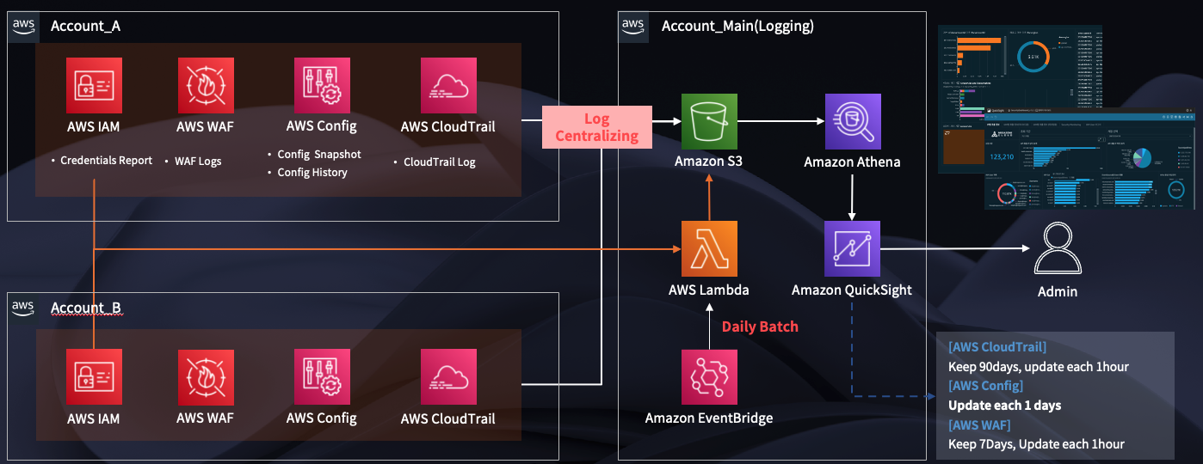
5
Required improvements
Priority Topic
KT has to enable AWS security services ( AWS Amazon CloudWatch, AWS CloudTrail ,etc.) as AIS policy and compile to AIS Guideline.
CloudTrail + CloudWatch
AWS CloudTrail is a logging service that records account activity across your AWS environment.
When a user, role, or service performs an action, it is logged as a CloudTrail event. You can view events in the Event History interface of the CloudTrail console, and by default, CloudTrail keeps logs for the last 90 days.
Based on tracking and saved logs through CloudTrail, you can send an alarm by generating a message in CloudWatch. The architecture can be applied in accordance with AIS policy.
For example, if you apply the requirement “A person’s notice is required when a login occurs in the AWS console,” you can use CloudTrail to receive logs and monitor them through CloudWatch.
Notes:
@ㅇ 숫자확인필요. Org의 숫자와 리소스의 숫자 확인. 필요시 org의 숫자는 제거.

Slide 12
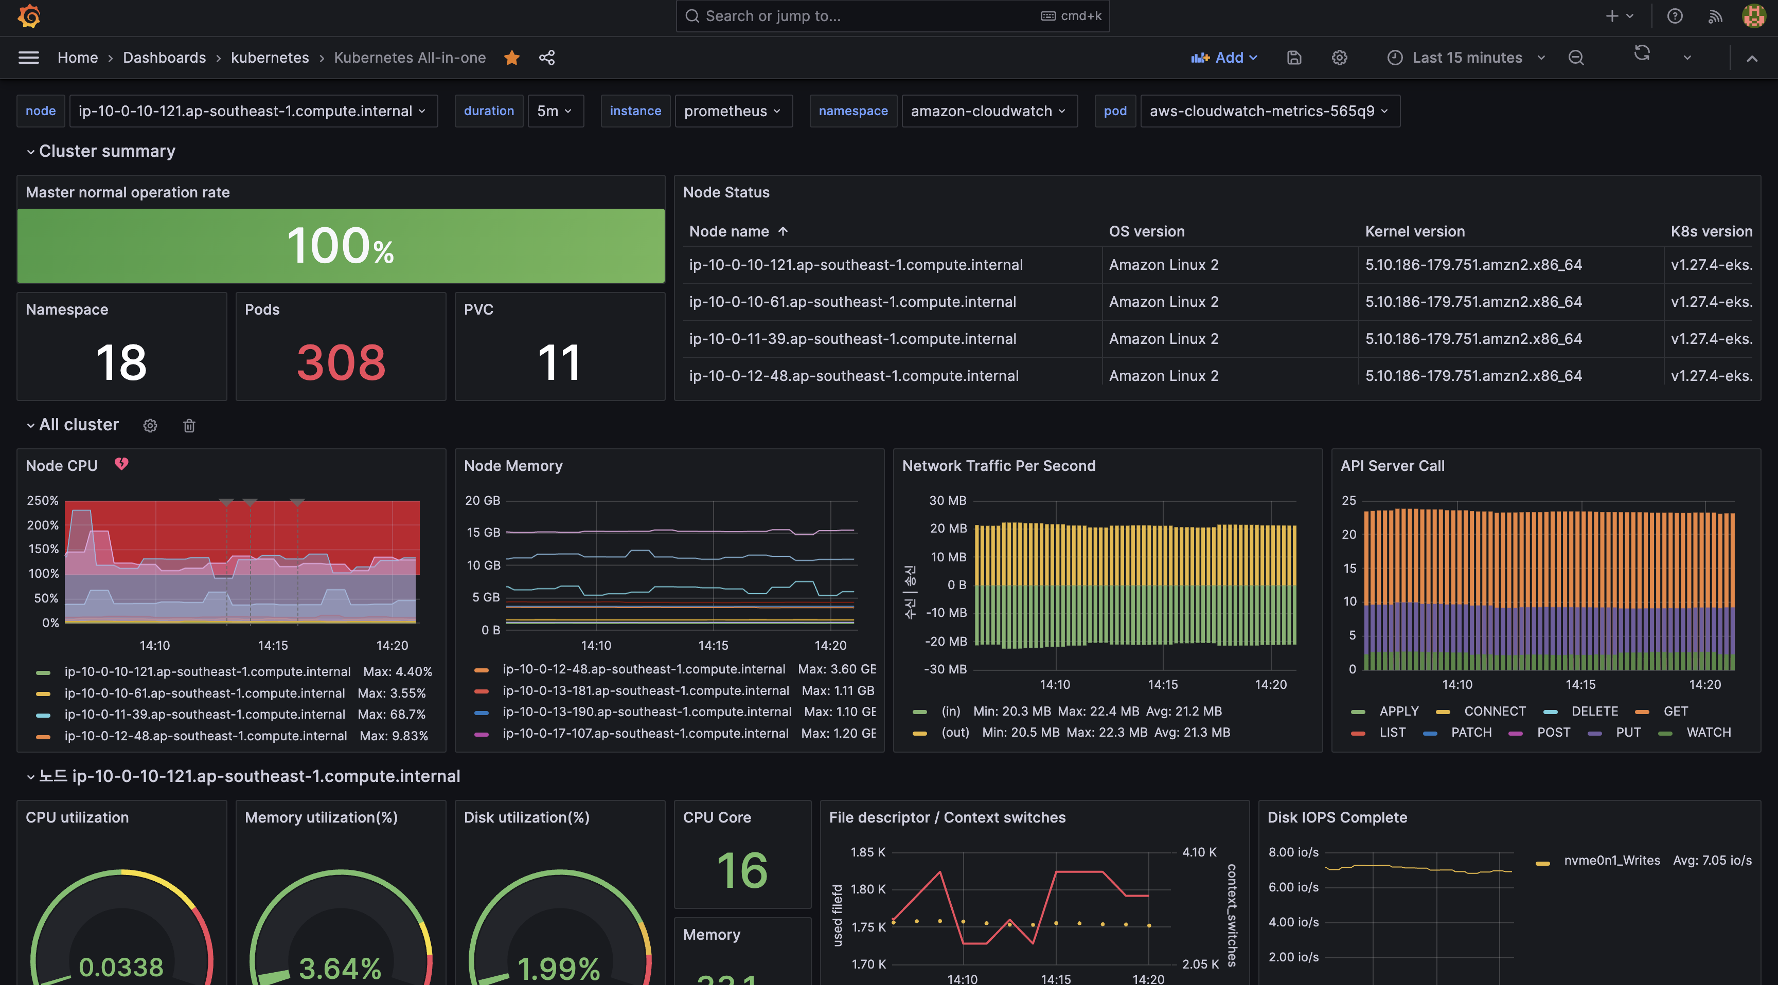
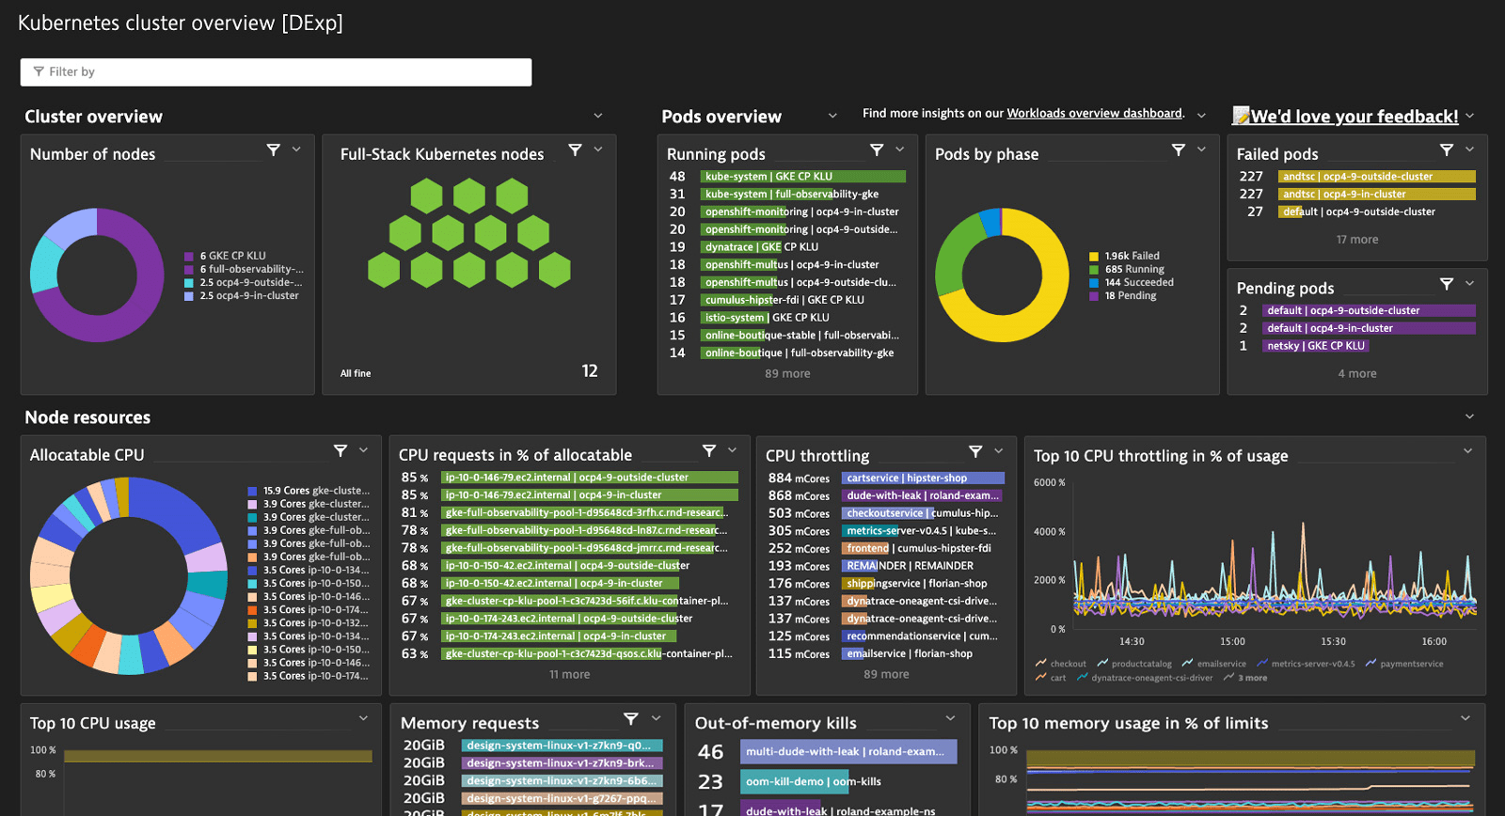
6
Required improvements
Priority Topic
KT agrees to develop a GUI for monitoring and maintenance tools for the operations team.
Customize Dynatrace to integrate Onpremise and AWS environments for monitoring in a single GUI environment. This allows you to check data such as applications, infrastructure, and solutions in one place, helping to quickly recognize and resolve failure situations.
Notes:
@ㅇ 숫자확인필요. Org의 숫자와 리소스의 숫자 확인. 필요시 org의 숫자는 제거.

Slide 13

7
Required improvements
Priority Topic
AIS and KT should collaborate design load test scenario together before execute the load test.
We plan to design a load test according to KT standards and select target API and set performance goals together with AIS.
KT standard performance test performance procedure
Analysis and goal setting
Design and preparation
Measure and improve performance
Results analysis and evaluation
business analytics
Develop a test plan
Unit performance verification
Results analysis and evaluation
1
1
1
1
AIS performance requirements analysis
Business/system change analysis
Establish test performance procedures
Measurement method definition
Selection of test target system/task
Measure individual business unit performance
Measure individual system performance
Analysis of measurement results
Review of performance adequacy
Review of measurement result adequacy
Comprehensive evaluation of test results
Integrated performance verification
2
Scenario and environment preparation
System-level performance measurements
Perform target load, critical load, and stability tests
Analysis and evaluation of measurement results
Setting performance goals
2
Configuration of utilization system
2
2
Define metrics and methods
Measurement scope definition
Define target level
Detailed test scenario definition
test script development
Configuration of load generation environment
Configuring performance analysis and collection environment
Scenario/Script Maintenance
Create a usage guide
Operator training and handover
Performance analysis and improvement
3
Identify performance vulnerabilities and bottlenecks
Improvement direction and impact analysis
Apply and verify improvements
※ Tasks subject to testing are selected in consultation with AIS, taking into account importance, call frequency, etc.
Notes:
@ㅇ 숫자확인필요. Org의 숫자와 리소스의 숫자 확인. 필요시 org의 숫자는 제거.

Slide 14

8
Required improvements
Priority Topic
KT must assign an engineer who can speak English to work with the team to improve communication.
For smooth communication during the project, KT will make up a project PM/PMO with engineers fluent in English.
AIS Project room
On-site (Thai)
KT
Dev Team
AIS
PMO/PM
KT
PMO/PM
KT
Dev Team
3BBTV
PM/PMO
Off-site (Korea)
Notes:
@ㅇ 숫자확인필요. Org의 숫자와 리소스의 숫자 확인. 필요시 org의 숫자는 제거.

Slide 15

9
Required improvements
Priority Topic
KT must provide an additional engineer with Google Ads expertise to contribute to the project.
KT’s experienced engineer for Google AD shall make sure seamless integration of Google AD Manager with VDO Platform.
AIS TH
Google
Managing End-to-End Steps to integrate and optimize AIS Google AD Service
AIS DMP
AD Analytics Audit
Ensuring tracking data is accurate throughout customer journey from ad exposure to conversion
DVP AD Inventory Integration
Making sure AIS PLAY AD format and placement type run perfectly
NPAW
OTT Device Integration
Google AD integration via IMA SDK and based on ADID policy; and custom integration to fulfill AIS PLAY AD product
AIS PLAY with IMA SDK
MW
KT DVP
Operation Simulation
A dedicated KT Engineer, for Google AD service, shall ensure seamless end-to-end operation, from google AD manager configuration to DVP platform configuration,.
Notes:
@ㅇ 숫자확인필요. Org의 숫자와 리소스의 숫자 확인. 필요시 org의 숫자는 제거.

Slide 16
10
Required improvements
Priority Topic
3BBTV must to improve KT's platform deeply knowledge and General OTT platform knowledge.
Notes:
@ㅇ 숫자확인필요. Org의 숫자와 리소스의 숫자 확인. 필요시 org의 숫자는 제거.

Slide 17
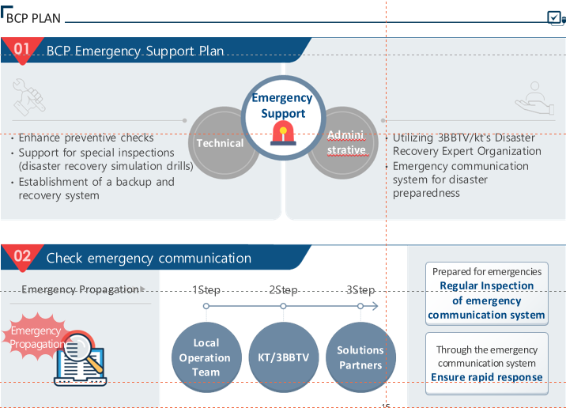
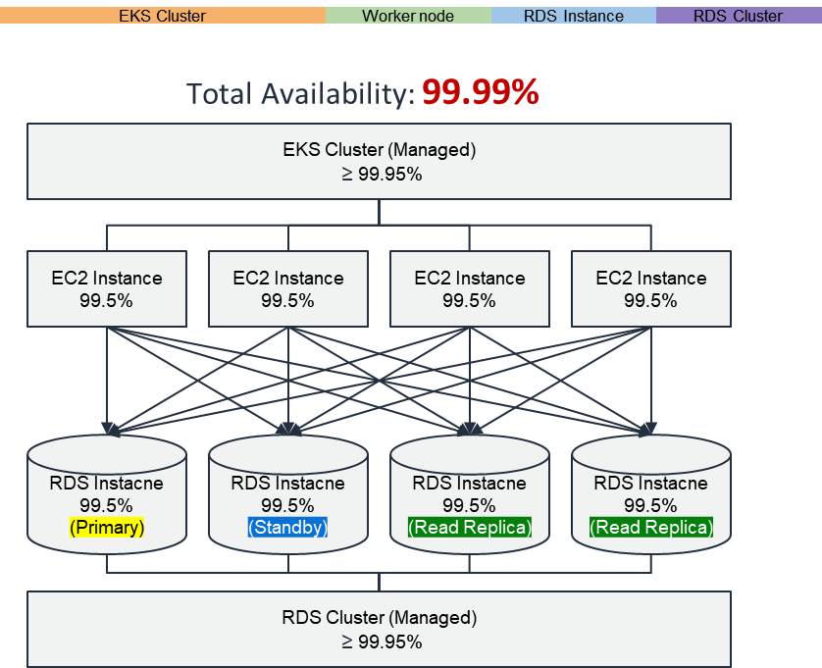
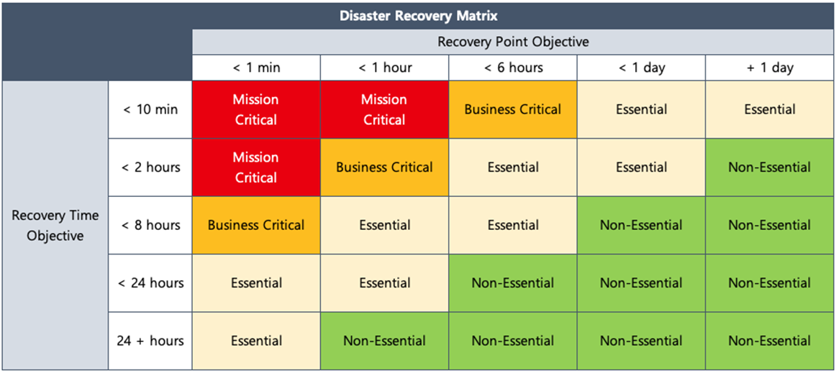
11
Required improvements
Priority Topic – BCP PLAN
KT needs to manage their 14 partners for the BCP plan
In the event of a disaster/failure, KT(including 14 soulutons) will establish the BCP strategy and restore the platform as soon as possible without service interruption for continuity of service.
KT will make up communication channel for rapid response in the event of an emergency to ensure the stability of the VDO Platform (including Infra).
KT will also conduct regular drills to ensure that we reach the RTO/SLA according to the priority of the service platform
Notes:
@ㅇ 숫자확인필요. Org의 숫자와 리소스의 숫자 확인. 필요시 org의 숫자는 제거.

Slide 18



11
Required improvements
Priority Topic – Software releases
KT needs to reduce the number of software releases.
The 3BBTV/KT VDO system builds a Devops tool chain to provide the 『PLAN - Deployment - Build - test - release - distribution - operation - monitoring system』.
Plan
Development
build
test
Test Plan ( Functional / Performance / Security )
API Automation Test Scripting
model testing statistical ( accuracy , precision , recall, etc. ) metrics and compute ( average latency, etc. ) metrics
submit
Taiga
Jira
Confluence
Git
Gradle
Maven
Docker
Sonarqube
Junit
Jmeter
Confirm project scope
WBS confirmed
Backlog based on WBS
Establish monitoring for visualization and quantitative measurement
Configuration management process definition
Specify branch strategy
Provides standards for branch names
Code Review Principles
Static / security policy reflection
Confirm
Release
distribution
operation
monitoring
Confirm operational workflow
Regular deployment / relearn cycle
Hotfix deployment strategy
monitoring , logging , and tracing systems
Feedback loop procedure
Taiga
Jira
Confluence
Prometheus/ Grafana
Grafana loki
Grafana Tempo
OpenTelemtry )
Argo
Argo
Check artifacts to be distributed
Establish a distribution strategy
When AIS team submit the requests, it issues a ticket in Jira to manage the life cycle.
A sprint 2-week retrospective is conducted to determine if each stage meets customer requirements
The system is established to distribute final confirmation to AIS customers through testing/code review
Notes:
@ㅇ 숫자확인필요. Org의 숫자와 리소스의 숫자 확인. 필요시 org의 숫자는 제거.

Slide 19
11
Required improvements
Priority Topic – Software releases
KT needs to reduce the number of software releases.
After VDO platform & FE app commercialization, SW releases operate on a regular deployment schedule (once a month) (exceptions – emergency deployments are always applicable)
[Example] Software release process
~ 2 Week : Develop and test SR(service requirements) to be released this month on Testbed Env (KT)
3 Week : Verify the SR on Staging Env (AIS teams & KT)
4 Week (Monday night) : Release/Montor the SR on Product Env (KT)`
Mon.
Tue.
Wen.
Thu.
Fri.
Sat.
Sun.
~ 1Week
Develop SR to be released this month
3rd party
VDO
OTT
ATV
~ 2Week
Goolge/Netfilx
(Auth)
KT teams do test the SR
VDO
OTT
ATV
~ 3Week
AIS teams verify/test the SR
3rd party
VDO
OTT
ATV
~4Week
Google/Apple
Sotre
Smart TV
Store
Service monitroing
SR Realse
VDO
OTT
ATV
Realse
**FE app will be released on the App Store or as APK upgrade process
Notes:
@ㅇ 숫자확인필요. Org의 숫자와 리소스의 숫자 확인. 필요시 org의 숫자는 제거.

Slide 20
12
Required improvements
Priority Topic
AIS and KT need to collaborate and learn together to continuously improve the design.
KT always consults with the AIS team regarding the advancement of all UIUX(App) and VDO platforms before designing.
Notes:
@ㅇ 숫자확인필요. Org의 숫자와 리소스의 숫자 확인. 필요시 org의 숫자는 제거.

